Slide 1
Informed Search 1

Slide 2
Outline
Best-first search
Greedy best-first search
A* search
Heuristics

Slide 3

Review: Tree search
A search strategy is defined by picking the order of node expansion

Slide 4
Uninformed Search strategies
Limitation:
Find solutions to problems by systematically generating new states and testing them against the goal
Inefficient

Slide 5
Informed Search strategies
Merits:
Makes use of problem specific knowledge
So, finds solutions more efficiently

Slide 6
Heuristics

Slide 7
Heuristics
Uninformed search methods expand nodes
  based on “distance” from start node
  Never look ahead to the goal
    E.g. in uniform cost search expand the cheapest path.
    We never consider the cost of getting to the goal
Advantage is that we have this information
  We often have some additional knowledge about the problem
  E.g. in traveling around Romania
  We know the distances between cities so can measure the overhead of going in the wrong direction

Slide 8
Heuristics
Our knowledge is often on the merit of nodes
  Value of being at a node
Different notions of merit
  If we are concerned about the cost of the solution, we might want a notion of how expensive it is to get from a state to a goal
  If we are concerned with minimizing computation, we might want a notion of how easy it is to get a state to a goal
We will focus on cost of solution

Slide 9
Heuristics
We need to develop a domain specific heuristic function, h(n)
h(n) guesses the cost of reaching the goal from node n
The heuristic function must be domain specific
  We often have some information about the problem that can be used in forming a heuristic function
So heuristics are domain specific

Slide 10
Heuristics
If h(n1) < h(n2) then we guess that it is cheaper to reach the goal from n1 than it is from n2
We require
h(n)=0 when n is a goal node
h(n)>= 0 for all other nodes

Slide 11
Heuristics
Evaluation function f is a heuristic estimate of
  how good the state is (high f good) or
  distance to goal (low f good).
Design of heuristic evaluation functions is an empirical problem.
  Can spend a lot of time designing and re-designing them
  Often no obvious answer.
  e.g. Write a function that estimates, for any state x in chess, how far that state is from checkmate.

Slide 12
Best-first search

Slide 13
Best-first search
The general approach is called best first search
  An instance of General TREE-SEARCH or GRAPH-SEARCH algorithm
  A node is selected for expansion based on an evaluation function f(n)
  Evaluation measures the distance to the goal
  A node with lowest evaluation is selected for expansion
The implementation of best-first graph search is identical to that for uniform-cost search except for the use of f instead of g to order the priority queue.

Slide 14
Family of Best-first search
With different evaluation functions
  A family of Best First Search algorithms arise
A key component of these algorithms is
  Heuristic function, denoted h(n)
  h(n) = estimated cost of the cheapest path from node n to a goal node
  A heuristic function h(n) takes a node as input, but depends only on the state at that node
Heuristic function is the most common form in which additional knowledge of the problem is imparted to the search algorithm
Now, consider them as arbitrary problem specific functions
Note that heuristic function for a goal node n is h(n) = 0

Slide 15
Best-first search
There are two ways to use heuristic information to guide search
Tries to expand the node closest to the goal on the grounds that this is likely to lead to a solution quickly.
  Greedy best-first search
Tries to expand the node on the least cost solution path.
  A* search

Slide 16
Greedy best-first search
Evaluates nodes by using only the heuristic function
Evaluation function f(n) = h(n) (heuristic)
=> estimated cost of cheapest path from n to goal node
Problem: Route finding problem in Romania using straight-line distance heuristic known as h_{SLD}(n)
e.g., h_{SLD}(n) = straight-line distance from n to Bucharest
Consider Goal: Bucharest

Slide 17

Romania with step costs in km
Note the correction : h SLD (Pitesti) = 100

Slide 18
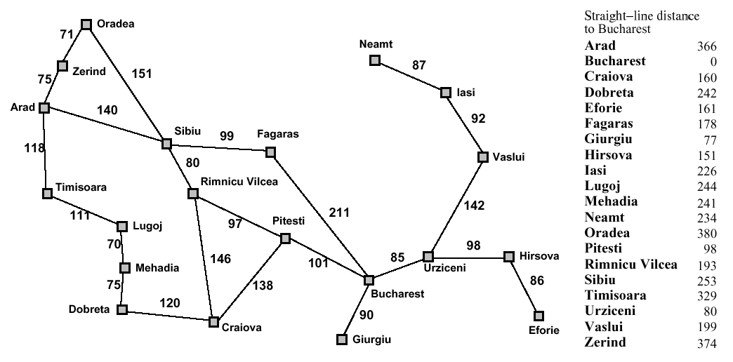
Problem - Romania with step costs in km
374
253
329
Note the correction : h SLD (Pitesti) = 100

Slide 19
Greedy best-first search
Note that the values of h_{SLD} cannot be computed from the problem description itself
h_{SLD} is correlated with actual road distances, so a useful heuristic
Greedy best-first search expands the node that appears to be closest to goal

Slide 20

Greedy best-first search: example
Note: Nodes are labeled with their h-values
Greedy best first search to find a path from Arad to Bucharest

Slide 21

Greedy best-first search: example

Slide 22

Greedy best-first search: example

Slide 23

Greedy best-first search: example

Slide 24
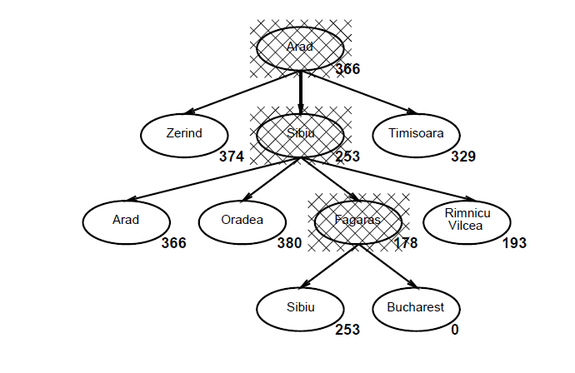
Greedy best-first search: example

Slide 25
Romania with step costs in km
Note the correction : h SLD (Pitesti) = 100

Slide 26
Greedy best-first search: properties
Greedy best first search using h_{SLD} finds a solution without ever expanding a node that is not on the solution path
So, search cost is minimal
Is it?

Slide 27
Greedy best-first search: properties
Is it optimal?
No
    Arad to Sibiu 140 km
    Sibiu to Fagaras 99 km
    Fagaras to Bucharest 211 km (Total : 450 km)
Path via Sibiu and Fagaras to Bucharest is 32km longer than the path through Rimnicu Vilcea and Pitesti (not h_{SLD} values refer to map values)
    Arad to Sibiu 140 km
    Sibiu to Rimnicu Vilcea 80 km
    Rimnicu Vilcea to Pitesti 97 km
    Pitesti to Bucharest 101 (Total: 418 km)

Slide 28
Optimal??
Optimal??
No (same as depth-first search)
Ex: from Arad to Bucharest
1) Arad → Sibiu → Fagaras → Bucharest
(450=140+99+211, is not shortest)
2) Arad → Sibiu → Rim → Pitesti → Bucharest
(418=140+80+97+101)
Optimal is 418

Slide 29
Greedy best-first search: properties
This is the reason why algorithm is called Greedy
“Greedy” - at each step it tries to get as close to the goal as it can

Slide 30
Greedy best-first search: properties
What happens if we minimize h(n)?
Susceptible to false starts
Problem: Consider getting from Iasi to Fagaras
Heuristic suggests
  that Neamt be expanded first, as it is closest to Fagaras but it is a dead end
Farther step according to heuristic is the solution
  The solution is to go to Vaslui
  Continue to Urziceni, Bucharst and Fagaras

Slide 31
Romania with step costs in km
Note the correction : h SLD (Pitesti) = 100

Slide 32
Greedy best-first search: properties
Greedy best-first tree search is incomplete even in a finite state space, much like depth-first search.
  Heuristic causes unnecessary nodes to be expanded
  If we are not careful to detect repeated states, the solution will never be found
  Search will oscillate between Neamt and Iasi
The graph search version is complete in finite spaces, but not in infinite ones

Slide 33
Greedy best-first search: properties
Resembles DFS
  Prefers to follow a single path to the goal but will back up when it hits dead end
Suffers from same limitations as DFS
  Not optimal, not complete
The worst case time and space complexity
  O(b^{m}) where m is the max. depth of the search space

Slide 34
Greedy best-first search: properties
The time and space complexity
  With a good heuristic function, the complexity can be reduced substantially
  The amount of reduction depends on the particular problem and on the quality of heuristic

Slide 35
Greedy best-first search: properties
Complete? No – can get stuck in loops, e.g., Iasi → Neamt → Iasi → Neamt →
Time? O(b^{m}), but a good heuristic can give dramatic improvement
Space? O(b^{m}) -- keeps all nodes in memory
Optimal? No

Slide 36
A* search
Greedy best-first search limitations
Greedy search minimizes the estimated cost to the goal h(n).
Unfortunately, it is neither optimal nor complete.
UCS Merits
The uniform cost search minimizes the cost of the path g(n). It is optimal and complete.
A* Search origin
It would be nice if we could combine these two strategies to get the advantage of both.

Slide 37
A* search
The most widely known best first search
Evaluation function f(n) = g(n) + h(n)
  g(n) = cost so far to reach node n
  h(n) = cost to get from node n to the goal
g(n) = path cost from start node to node n
h(n) = estimated cost of the cheapest path from n to goal
f(n) = estimated cost of the cheapest solution through n to goal
Note: The A stands for “Algorithm”, and the * indicates its optimality property.

Slide 38
A*
A* combines the greedy search with the uniform-search strategy.
  g(n) = actual cost from the initial state to n.
  h(n) = estimated cost from n to the closest goal.
f(n) = g(n) + h(n), the estimated cost of the cheapest solution
  through n.
The algorithm is identical to UNIFORM-COST-SEARCH except that A* uses g + h instead of g.
Let C* (or h*(n)) be the actual cost of the optimal path from n to the closest goal

Slide 39
Cost of Optimal Solution C* (h*(n)) from Arad to Bucharest
By referring to map values (not table values of h_{SLD} )
1) Non – optimal
    Path from Arad via Sibiu and Fagaras to Bucharest is
        Arad to Sibiu 140
        Sibiu to Fagaras 99
        Fagaras to Bucharest 211 (Total : 450 km)
2) Optimal
    Path from Arad via Sibiu and Rimnicu Vilcea and Pitesti and to Bucharest is
        Arad to Sibiu 140
        Sibiu to Rimnicu Vilcea 80
        Rimnicu Vilcea to Pitesti 97
        Pitesti to Bucharest 101 (Total: 418 km)
Path via Sibiu and Fagaras to Bucharest is 32km longer than the path through Rimnicu Vilcea and Pitesti
So, cost of optimal solution is 418

Slide 40
A* search
Idea: avoid expanding paths that are already expensive
So, to find the cheapest solution, the node with the lowest value of g(n) + h(n) is chosen

Slide 41
Romania with step costs in km
Note the correction : h SLD (Pitesti) = 100

Slide 42

A* search: example

Slide 43

A* search: example

Slide 44

A* search: example

Slide 45

A* search: example

Slide 46

A* search: example

Slide 47

A* search: example

Slide 48
A* search
A* search is both complete and optimal.
  provided that the heuristic function h( n) satisfies certain conditions
Conditions for optimality: Admissibility and consistency

Slide 49
A* Search properties
The first condition we require for optimality is that h(n) be an admissible heuristic.

Slide 50
Admissible heuristics
An admissible heuristic never overestimates the cost to reach the goal, i.e., it is optimistic
  Example: h_{SLD}(n) is admissible because the shortest path between any two points is a straight line
  The straight line cannot be an over estimate
A heuristic h(n) is admissible
if for every node n, h(n) ≤ h*(n), where h*(n) is the true cost to reach the goal state from n.
That is, an admissible heuristic thinks that the cost of solving the problem (which is h(n)) is less than actually it is (which is h*(n) )

Slide 51
Preliminary - Admissible heuristic is a lower bound
Definition (admissible heuristic): A search heuristic h(n) is admissible if it is never an overestimate of the cost from n to a goal.
There is never a path from n to a goal that has path length less than h(n).
Another way of saying this: h(n) is a lower bound on the cost of getting from n to the nearest goal.
Note: Because g(n) is the actual cost to reach n along the current path, and f(n) = g(n) + h(n), we have as an immediate consequence that f(n) never overestimates the true cost of a solution along the current path through n

Slide 52
Admissible heuristics
Example: The h(n) values given in the table for Romania Map are admissible.
Ex: Consider problem of going from Arad to Bucharest.
    h(n) = estimated cost from n to the closest goal.
  C* or h*(n) is the actual cost of the optimal path from n to the closest goal
h*(n) from Arad to Bucharest is Arad → Sibiu → Rim → Pitesti → Bucharest (418=140+80+97+101)
hSLD (n) from Arad to Bucharest is 366 from Table
So, it can be verified that h(n) <= C*. This is true for every h_{SLD} value shown in Table.
  Admissible - hence the heuristic function is always a lower bound on actual solution cost.

Slide 53
Consistent heuristics
A second, slightly stronger condition called consistency (or sometimes monotonicity) is required only for applications of A* to graph search.

Slide 54

Consistent heuristics
A heuristic h(n) is consistent if for every node n and every successor n' of n generated by any action a, the estimated cost of reaching the goal from n is not greater than the step cost of getting to n' plus the estimated cost of reaching the goal from n'
i.e., h(n) ≤ c(n,a,n') + h(n')
A form of general triangle inequality
  States that each side of a triangle cannot
  be greater than the sum of the other 2 sides
Here, triangle is formed by n , n' and the goal closest to n

Slide 55
Consistent heuristics
It is easy to show that every consistent heuristic is also admissible
Consistency is a stricter requirement than admissibility
All the admissible heuristics discussed in this chapter are also consistent
Ex: h_{SLD} is a consistent heuristic
  The general triangle inequality is satisfied when each side is measured by the straight line distance
  So, SLD between n and n’ is no greater than c(n,a,n')
  Hence, h_{SLD} is a consistent heuristic

Slide 56
Consistent heuristics
The tree-search version of A* is optimal if h( n) is admissible, while the graph-search version is optimal if h( n) is consistent.
We show the second of these two claims since it is more useful.
The argument is same as that of optimality of uniform-cost search, with g replaced by f
The first step is to establish the following:
if h( n) is consistent, then the values of f ( n) along any path are nondecreasing.
The proof follows directly from the definition of consistency.

Slide 57
A* Search : Consistent heuristics
Proof: Follows from the definition of consistency
If h is consistent, we have the following:
Suppose n’ is a successor of n
Then g(n’) = g(n) + c(n,a,n')
We have
f(n') = g(n') + h(n')
= g(n) + c(n,a,n') + h(n')
≥ g(n) + h(n)
≥ f(n)
So, f(n’) >= f(n) so f never decreases along any path
i.e., f(n) is non-decreasing along any path.
Thus, first goal-state selected for expansion must be optimal

Slide 58
A* Search : Consistent heuristics
It follows that the sequence of nodes expanded by A* using GRAPH-SEARCH is in non-decreasing order of f(n)
The next step is to prove that whenever A* selects a node n for expansion, the optimal path to that node has been found.
Hence, the first goal node selected for expansion must be an optimal solution
  Since all later nodes will be at least as expensive
The fact that f-costs are non decreasing along any path also means that we can draw contours in the state space

Slide 59
A* Search
it follows that the sequence of nodes expanded by A* using GRAPH-SRARCH is in nondecreasing order of f(n).
Hence, the first goal node selected for expansion must be an optimal solution because f is the true cost for goal nodes
Goal nodes have h = 0 and all later goal nodes will be at least as expensive.

Slide 60

Contours of A* Search
Note: breadth-first/uniform cost adds layers whereas A∗ “stretches” towards goal

Slide 61
Contours of A* Search
A* expands nodes in order of increasing f value
Thus, A* expands the frontier node of lowest f-cost, it forms concentric bands of increasing f-cost starting from the start node
Gradually adds "f-contours" of nodes
Contour i has all nodes with f=f_{i}, where f_{i} < f_{i+1}
Note: Inside contour labeled 400, all nodes have f (n) values <= 400 and so on

Slide 62
Contours of A* Search
With uniform-cost (A* search using h(n) = 0), contours will be circular around the start state
With accurate heuristics, contours will be stretched toward the goal state and become focused around optimal path
Note: In the first contour, node Arad with f-cost 366 is expanded.
Then, second contour is stretched to node Sibiu with f-cost 393. Hence, second contour is shown around node Sibiu with value 400.
At third contour, nodes, Rimnic Vilcea(413), Fagara(415), Pitesti(417) and Bucharest (418) have been selected. Hence the third contour is labeled as 420 meaning all nodes <= 420 have been expanded

Slide 63
A* Search: Evaluation
Let C* be the cost of optimal solution
Then, we say the following
  1) A* expands all the nodes with f(n) < C*
    2) A* might expand some of the nodes right on the “goal contour” where f(n)=C* before selecting a goal node
Intuitively, it is obvious that the first solution found must be an optimal one
  Because goal nodes in all subsequent contours will have higher f-cost
  Thus higher g-cost (since goal nodes have h(n) = 0)
It then means that A* search is complete

Slide 64
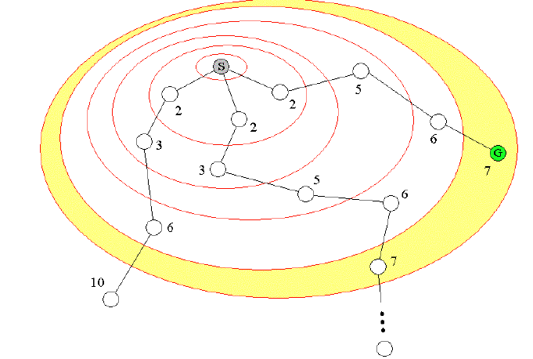
A* Search : properties
For any contour, A* examines all of the nodes in the contour before looking at any contours further out. If a solution exists, the goal node in the closest contour to the start node will be found first.

Slide 65
A* Search: Characteristics
A* expands no nodes with f(n) > C*
  These nodes are said to be pruned
  Ex: Timisoara is not expanded even though it is a child of the root
  So, sub tree below Timisoara is pruned
  Because h_{SLD} is admissible, the algorithm can safely ignore this sub tree
  This pruning still guarantees optimality
  The concept of pruning - eliminating possibilities from consideration without having to examine them – is important for many areas of AI

Slide 66
A* Search: Characteristics
  Cannot expand f_{i+1} until f_{i} is finished.
  A* expands all nodes with f(n)< C* (where C* is cost of optimal soln.)
  A* might expand some nodes with f(n)=C*
  A* expands no nodes with f(n)>C*
Note: A* has expanded all of the following nodes with f(n) < C*
Ex: Arad (366), Sibiu(393), Rimnicu Vilcea (413), Fagaras (415), Pitesti (417)
C* is 418 and the f-values are shown in brackets

Slide 67
A* Search: Characteristics
Among optimal algorithms – algorithms that extend search paths from the root – A* is optimally efficient for any given heuristic function
Optimally efficient - No other optimal algorithm is guaranteed to expand fewer nodes than A*
  For a given heuristic, A* finds optimal solution with the fewest number of nodes expansion
  That is, no other optimal algorithm is guaranteed to expand fewer nodes than A*
  This is because, any algorithm that does not expand all nodes with f(n) < C* has the risk of missing the optimal solution

Slide 68
A* Search: Characteristics
A* is complete
A* is optimal
A* is optimally efficient

Slide 69
A* Search: Evaluation
Time complexity:
  However, the number of nodes within the goal contour is still exponential in the length of the solution
Space complexity:
    All nodes are stored (in frontier)
      Hence space is the major problem not time
Completeness: YES
Optimality: YES
  Cannot expand f_{i+1} until f_{i} is finished.
  A* expands all nodes with f(n)< C* (cost of optimal soln.)
  A* expands some nodes with f(n)=C*
  A* expands no nodes with f(n)>C*
Also optimally efficient

Slide 70
A* Search: Evaluation
  Time complexity:
  However, the number of nodes within the goal contour is still exponential in the length of the solution
  Exponential growth will occur unless error in h(n) grows no faster than log (true path cost)
  In practice, error is usually proportional to true path cost (not log)
  So exponential growth is common
  It is impractical to insist on finding an optimal solution
  There are variants of A* that can find sub optimal solutions quickly
  Heuristics that are designed are more accurate, but not strictly admissible
  The use of a good heuristic provides enormous saving compared to the use of an uninformed search

Slide 71
A* Search
Space complexity:
All nodes are stored
  So A* is not practical for many large scale problems
There are new algorithms which have
  Overcome the space problem
  Still preserving optimality and completeness at a small cost in execution time

Slide 72
Quality of heuristics in A*
If the heuristic is useless (ie h(n) is hardcoded as equal to 0 ), the algorithm degenerates to uniform cost.
If the heuristic is perfect, there is no real search, we just march down the tree to the goal.
Generally we are somewhere in between the two situations above.
So, the time taken depends on the quality of the heuristic.

Slide 73
Exercise Problem
Trace the operation of 1) A* search applied to the problem of getting to Bucharest from Lugoj using the SLD heuristic. Show the sequence of nodes that the algorithm will consider and the f, g and h score for each node
2)Repeat the same using Greedy Best First Search

Slide 74
Romania with step costs in km
Note the correction : h SLD (Pitesti) = 100

Slide 75


Slide 76
Informal proof outline of A* completeness
Assume that every operator has some minimum positive cost, epsilon.
Assume that a goal state exists, therefore some finite set of operators lead to it.
Expanding nodes produces paths whose actual costs increase by at least epsilon each time.
Since the algorithm will not terminate until it finds a goal state, it must expand a goal state in finite time.

Slide 77
Informal proof outline of A* optimality
When A* terminates, it has found a goal state
All remaining nodes have an estimate cost to goal (f(n)) greater than or equal to that of goal we have found.
Since the heuristic function was optimistic, the actual cost to goal for these other paths can be no better than the cost of the one we have already found.

